Slide 1
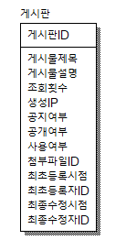
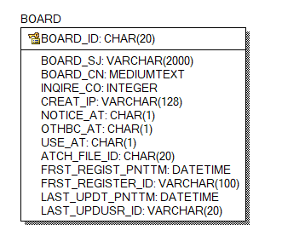

Slide 2
CREATE TABLE BOARD
(
BOARD_ID CHAR(20) NOT NULL,
BOARD_SJ VARCHAR(2000) NULL,
BOARD_CN MEDIUMTEXT NULL,
INQIRE_CO INTEGER NULL,
CREAT_IP VARCHAR(30) NULL,
NOTICE_AT CHAR(1) NULL,
OTHBC_AT CHAR(1) NULL,
USE_AT CHAR(1) NULL,
ATCH_FILE_ID CHAR(20) NULL,
FRST_REGIST_PNTTM DATETIME NULL,
FRST_REGISTER_ID VARCHAR(100) NULL,
LAST_UPDT_PNTTM DATETIME NULL,
LAST_UPDUSR_ID VARCHAR(20) NULL
);
ALTER TABLE BOARD
ADD PRIMARY KEY (BOARD_ID);

Slide 3
ALTER TABLE BOARD COMMENT = '게시판';
ALTER TABLE BOARD CHANGE COLUMN BOARD_ID BOARD_ID CHAR(20) NOT NULL COMMENT '게시판ID';
ALTER TABLE BOARD CHANGE COLUMN BOARD_SJ BOARD_SJ VARCHAR(2000) NULL COMMENT '게시물제목';
ALTER TABLE BOARD CHANGE COLUMN BOARD_CN BOARD_CN MEDIUMTEXT NULL COMMENT '게시물설명';
ALTER TABLE BOARD CHANGE COLUMN INQIRE_CO INQIRE_CO INTEGER NULL COMMENT '조회횟수';
ALTER TABLE BOARD CHANGE COLUMN CREAT_IP CREAT_IP VARCHAR(30) NULL COMMENT '생성IP';
ALTER TABLE BOARD CHANGE COLUMN NOTICE_AT NOTICE_AT CHAR(1) NULL COMMENT '공지여부';
ALTER TABLE BOARD CHANGE COLUMN OTHBC_AT OTHBC_AT CHAR(1) NULL COMMENT '공개여부';
ALTER TABLE BOARD CHANGE COLUMN USE_AT USE_AT CHAR(1) NULL COMMENT '사용여부';
ALTER TABLE BOARD CHANGE COLUMN ATCH_FILE_ID ATCH_FILE_ID CHAR(20) NULL COMMENT '첨부파일ID';
ALTER TABLE BOARD CHANGE COLUMN FRST_REGIST_PNTTM FRST_REGIST_PNTTM DATETIME NULL COMMENT '최초등록시점';
ALTER TABLE BOARD CHANGE COLUMN FRST_REGISTER_ID FRST_REGISTER_ID VARCHAR(100) NULL COMMENT '최초등록자ID';
ALTER TABLE BOARD CHANGE COLUMN LAST_UPDT_PNTTM LAST_UPDT_PNTTM DATETIME NULL COMMENT '최종수정시점';
ALTER TABLE BOARD CHANGE COLUMN LAST_UPDUSR_ID LAST_UPDUSR_ID VARCHAR(20) NULL COMMENT '최종수정자ID';

Slide 4
INSERT INTO ids
(TABLE_NAME, NEXT_ID)
VALUES('BOARD_ID', 1);
<!-- BOARD START-->
<bean name="egovBoardIdGnrService" class="org.egovframe.rte.fdl.idgnr.impl.EgovTableIdGnrServiceImpl" destroy-method="destroy">
<property name="dataSource" ref="egov.dataSource" />
<property name="strategy" ref="boardStrategy" />
<property name="blockSize" value="10"/>
<property name="table" value="IDS"/>
<property name="tableName" value="BOARD_ID"/>
</bean>
<bean name="boardStrategy" class="org.egovframe.rte.fdl.idgnr.impl.strategy.EgovIdGnrStrategyImpl">
<property name="prefix" value="BOARD_" />
<property name="cipers" value="14" />
<property name="fillChar" value="0" />
</bean>
<!-- BOARD END-->

Slide 5

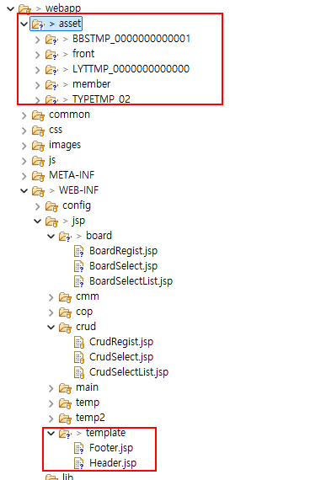
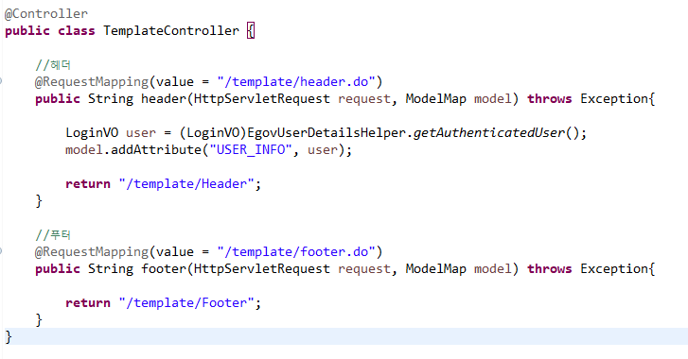
Header, Footer 작업 및 리소스 적용

Slide 6
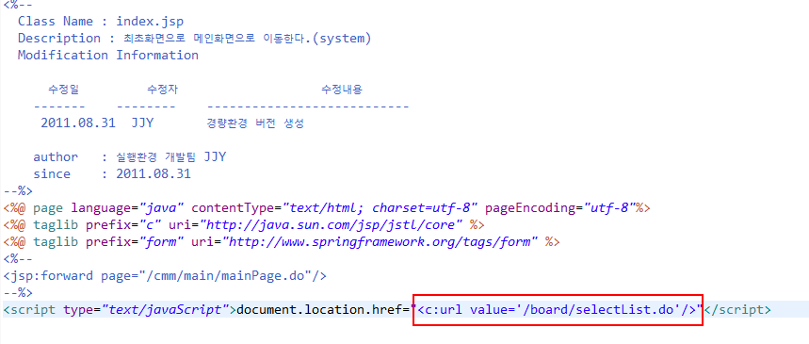
index.jsp 경로수정

Slide 7
목록 작업 후 데이터 확인
INSERT INTO BOARD (
BOARD_ID
, BOARD_SJ
, INQIRE_CO
, NOTICE_AT
, OTHBC_AT
, USE_AT
, FRST_REGIST_PNTTM
, FRST_REGISTER_ID
, LAST_UPDT_PNTTM
, LAST_UPDUSR_ID
) VALUES (
'BOARD_X0000000000001'
, '제목1'
, 0
, 'Y'
, 'Y'
, 'Y'
, NOW()
, 'admin'
, NOW()
,'admin'
)
INSERT INTO BOARD (
BOARD_ID
, BOARD_SJ
, INQIRE_CO
, NOTICE_AT
, OTHBC_AT
, USE_AT
, FRST_REGIST_PNTTM
, FRST_REGISTER_ID
, LAST_UPDT_PNTTM
, LAST_UPDUSR_ID
) VALUES (
'BOARD_X0000000000002'
, '제목2'
, 0
, 'N'
, 'N'
, 'Y'
, NOW()
, 'admin'
, NOW()
,'admin'
)
INSERT INTO BOARD (
BOARD_ID
, BOARD_SJ
, INQIRE_CO
, NOTICE_AT
, OTHBC_AT
, USE_AT
, FRST_REGIST_PNTTM
, FRST_REGISTER_ID
, LAST_UPDT_PNTTM
, LAST_UPDUSR_ID
) VALUES (
'BOARD_X0000000000003'
, '제목3'
, 0
, 'Y'
, 'N'
, 'Y'
, NOW()
, 'admin'
, NOW()
,'admin'
)

Slide 8
비밀 글 확인 용(등록 후 로그인하면서 암호를 변경해야 함)
INSERT INTO lettnemplyrinfo (
EMPLYR_ID
, ORGNZT_ID
, USER_NM
, PASSWORD
, GROUP_ID
, PSTINST_CODE
, EMPLYR_STTUS_CODE
, ESNTL_ID
, PASSWORD_HINT
, PASSWORD_CNSR
) SELECT
'user1'
, ORGNZT_ID
, '사용자1'
, PASSWORD
, GROUP_ID
, PSTINST_CODE
, EMPLYR_STTUS_CODE
, 'USRCNFRM_00000000001'
, '비밀번호 힌트'
, '비밀번호 답'
FROM lettnemplyrinfo
WHERE EMPLYR_ID = 'admin'
INSERT INTO lettnemplyrinfo (
EMPLYR_ID
, ORGNZT_ID
, USER_NM
, PASSWORD
, GROUP_ID
, PSTINST_CODE
, EMPLYR_STTUS_CODE
, ESNTL_ID
, PASSWORD_HINT
, PASSWORD_CNSR
) SELECT
'user2'
, ORGNZT_ID
, '사용자2'
, PASSWORD
, GROUP_ID
, PSTINST_CODE
, EMPLYR_STTUS_CODE
, 'USRCNFRM_00000000002'
, '비밀번호 힌트'
, '비밀번호 답'
FROM lettnemplyrinfo
WHERE EMPLYR_ID = 'admin'

Slide 9
* 첨부파일 작업 시 진행
globals.properties
# file경로
Globals.File = D:/JAVA_PROJECTS/kopo/2023/homepage/workspace/.metadata/.plugins/org.eclipse.wst.server.core/tmp0/wtpwebapps/homepage2023
context-properties.xml
<entry key="board.fileStorePath" value="${Globals.File}/upload/board/"/>
<entry key="photoThumbWidth" value="200"/>
<entry key="photoThumbHeight" value="140"/>

